Slide 1
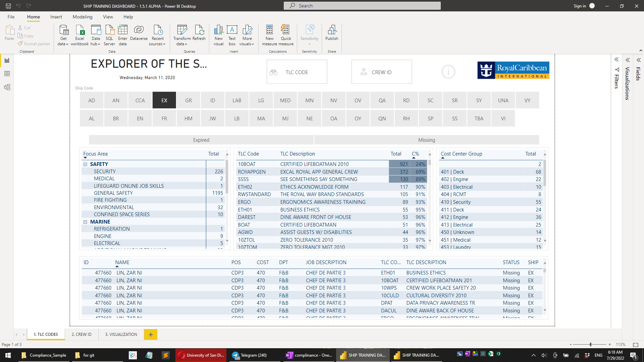

Slide 2
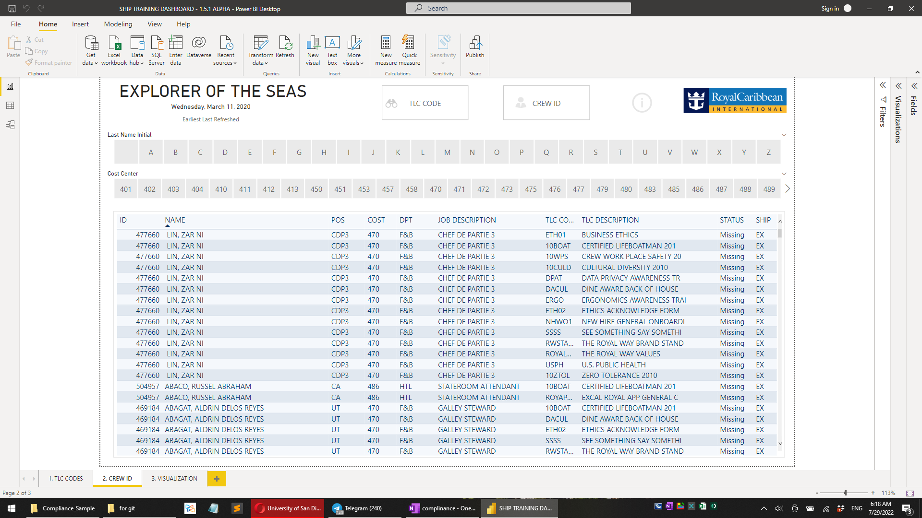

Slide 3
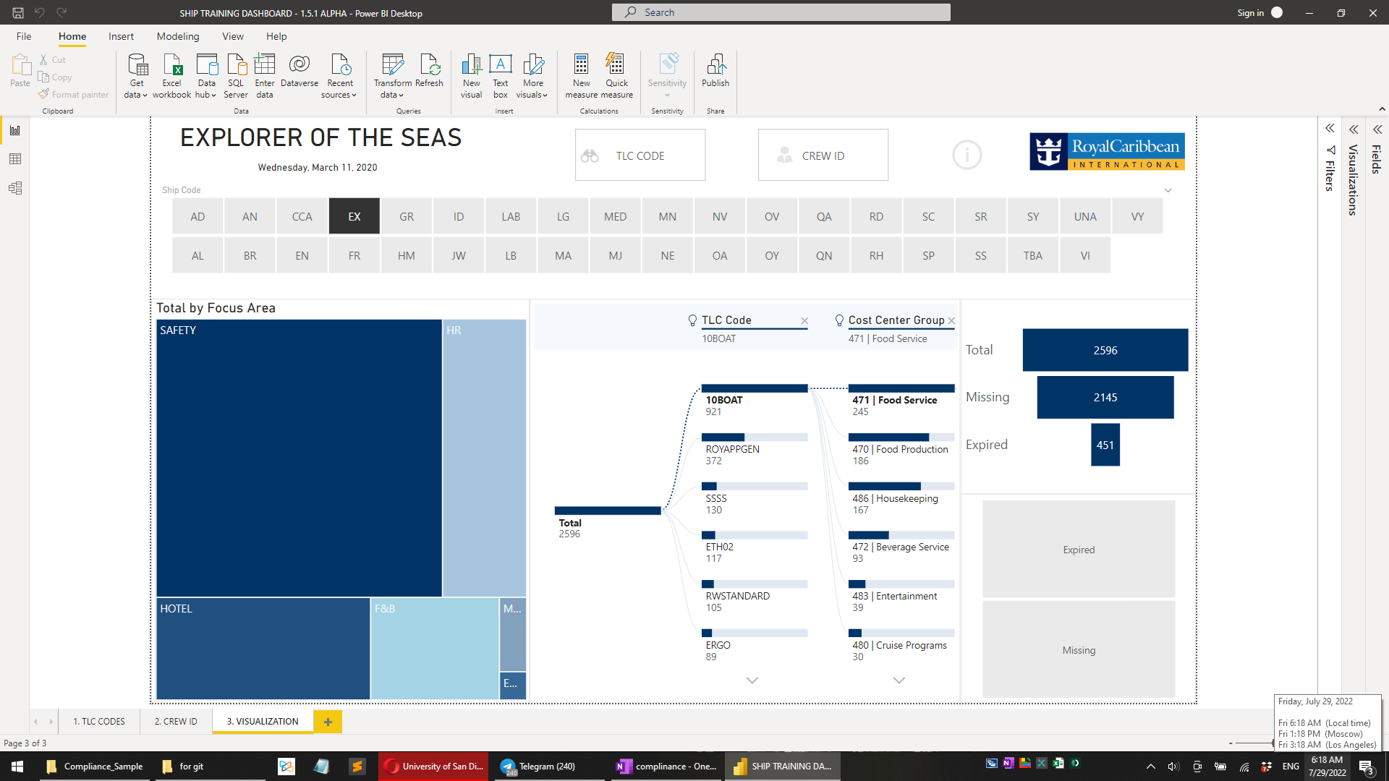

Slide 4
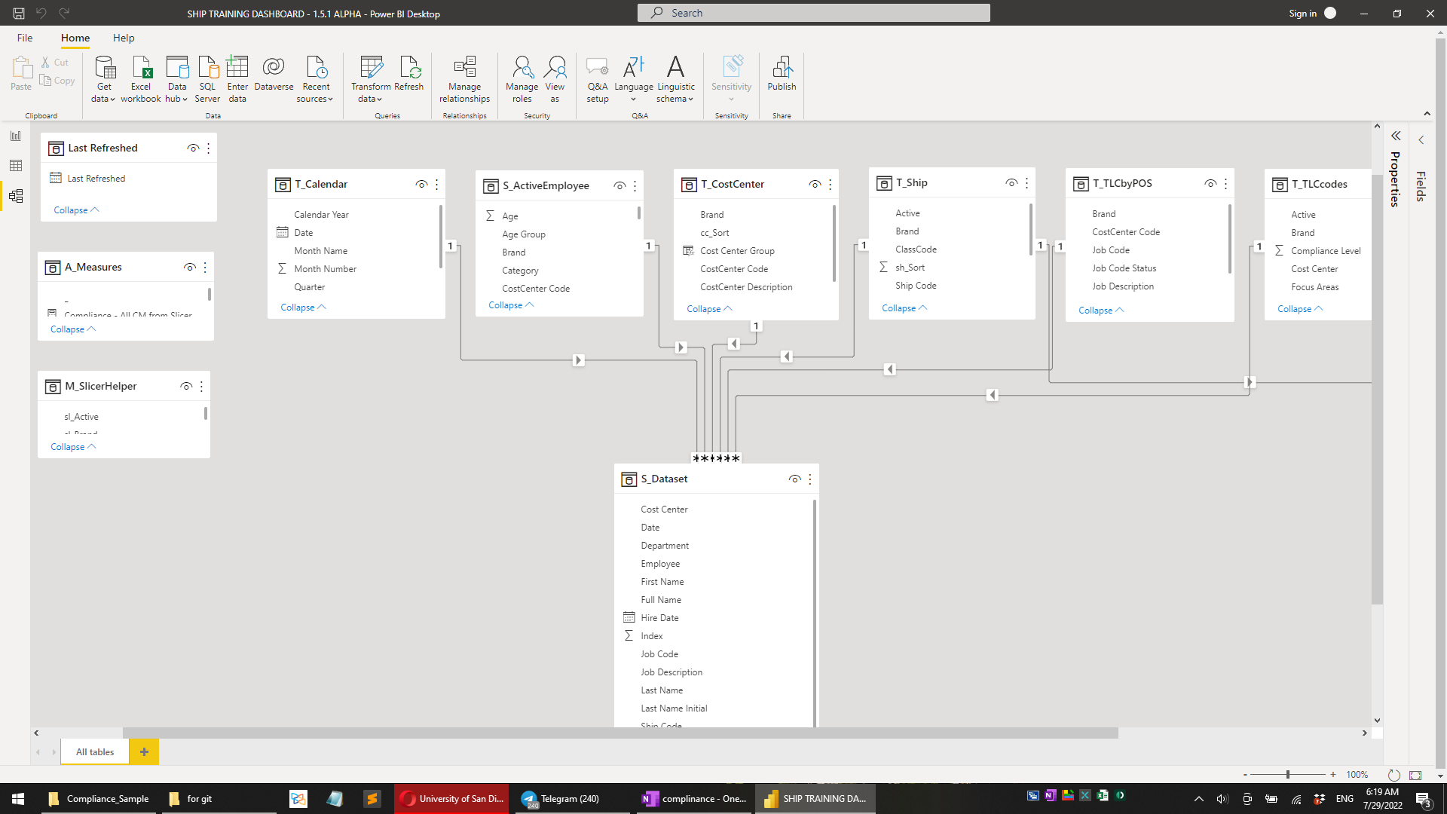

Slide 5
let
Source = Csv.Document(File.Contents("C:\Users\SuperManu\Desktop\Compliance_Sample\S_Dataset.csv"),[Delimiter=",", Columns=21, Encoding=65001, QuoteStyle=QuoteStyle.None]),
#"===START: Determine Data Start Row===" = 1,
#"Added Index" = Table.AddIndexColumn(Source, "Index", 1, 1),
#"Filtered by Selection" = Table.SelectRows(#"Added Index", each ([Column1] = "Selection:")),
#"Data Start Row" = #"Filtered by Selection"{0}[Index],
#"===END: Determine Data Start Row===" = 1,
#"Transforming - Start" = Table.Skip(#"Added Index",#"Data Start Row" - 1),
#"Renamed Columns" = Table.RenameColumns(#"Transforming - Start",{{"Column4", "Ship Code"}, {"Column1", "Employee"}, {"Column2", "Full Name"}}),
#"Removed Columns" = Table.RemoveColumns(#"Renamed Columns",{"Column3", "Column5"}),
#"Renamed Columns1" = Table.RenameColumns(#"Removed Columns",{{"Column6", "Hire Date"}, {"Column7", "Stat"}, {"Column8", "Sign On"}, {"Column9", "Job Code"}, {"Column10", "Job Description"}}),
#"Removed Columns1" = Table.RemoveColumns(#"Renamed Columns1",{"Column11", "Column12", "Column15", "Column16"}),
#"Renamed Columns2" = Table.RenameColumns(#"Removed Columns1",{{"Column13", "TLC Code"}, {"Column14", "TLC Description"}, {"Column17", "Department"}, {"Column18", "Cost Center"}, {"Column19", "Status"}, {"Column20", "Date"}, {"Column21", "Cat"}}),
#"Replaced Value" = Table.ReplaceValue(#"Renamed Columns2","",null,Replacer.ReplaceValue,{"Ship Code"}),
#"Filled Down" = Table.FillDown(#"Replaced Value",{"Ship Code"}),
#"Filtered Rows" = Table.SelectRows(#"Filled Down", each [Employee] <> null and [Employee] <> ""),
#"Removed Top Rows1" = Table.Skip(#"Filtered Rows",3),
#"Filtered Rows1" = Table.SelectRows(#"Removed Top Rows1", each [Employee] <> "***************"),
#"Changed Type" = Table.TransformColumnTypes(#"Filtered Rows1",{{"Employee", Int64.Type}, {"Hire Date", type date}, {"Sign On", type date}, {"Date", type date}}),
#"Duplicated Column" = Table.DuplicateColumn(#"Changed Type", "Full Name", "Full Name - Copy"),
#"Split Column by Delimiter" = Table.SplitColumn(#"Duplicated Column", "Full Name - Copy", Splitter.SplitTextByEachDelimiter({","}, QuoteStyle.Csv, false), {"Full Name - Copy.1", "Full Name - Copy.2"}),
#"Duplicated Column1" = Table.DuplicateColumn(#"Split Column by Delimiter", "Full Name - Copy.1", "Full Name - Copy.1 - Copy"),
#"Extracted First Characters" = Table.TransformColumns(#"Duplicated Column1", {{"Full Name - Copy.1 - Copy", each Text.Start(_, 1), type text}}),
#"Renamed Columns3" = Table.RenameColumns(#"Extracted First Characters",{{"Full Name - Copy.1 - Copy", "Last Name Initial"}, {"Full Name - Copy.2", "First Name"}, {"Full Name - Copy.1", "Last Name"}}),
#"Removed Columns2" = Table.RemoveColumns(#"Renamed Columns3",{"Cat"}),
#"Added Custom" = Table.AddColumn(#"Removed Columns2", "TLC_POS_Key", each [TLC Code] & "|" & [Job Code])
in
#"Added Custom"

